Slide 1

The Historic Nashville City Cemetery
And How It’s Records Help Document the Horrible History of Chattel Slavery in the United States of America

Slide 2
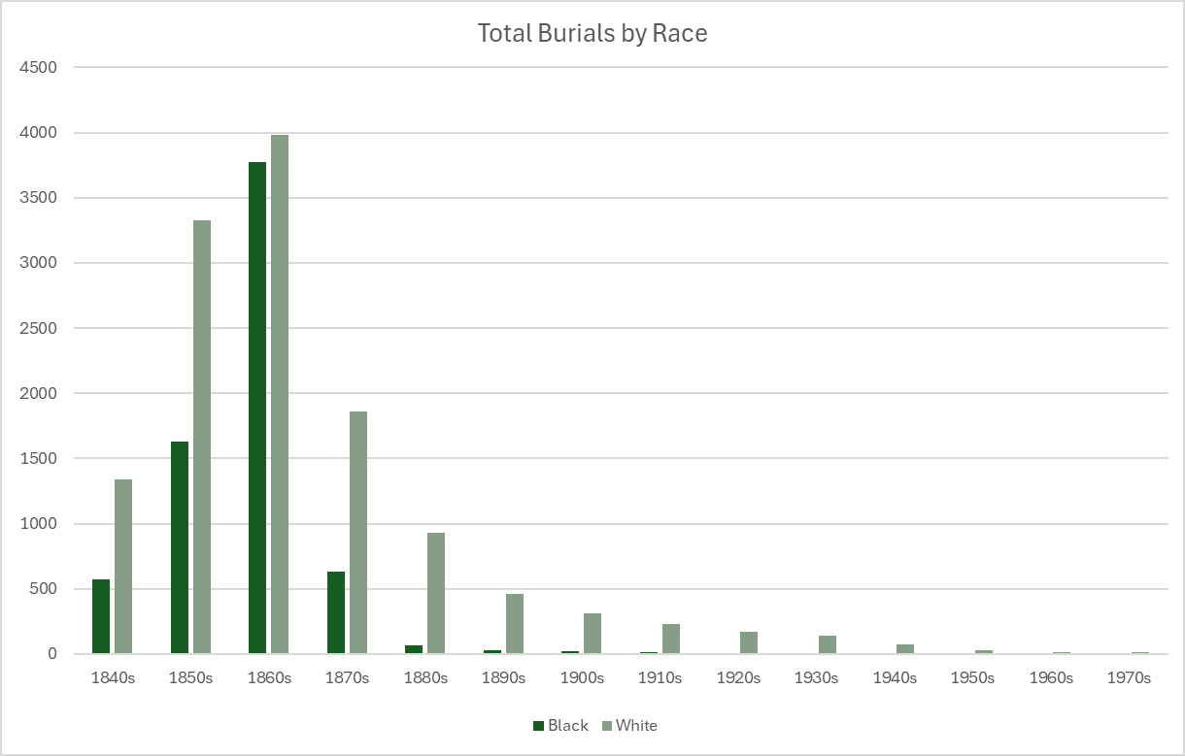

Slide 3
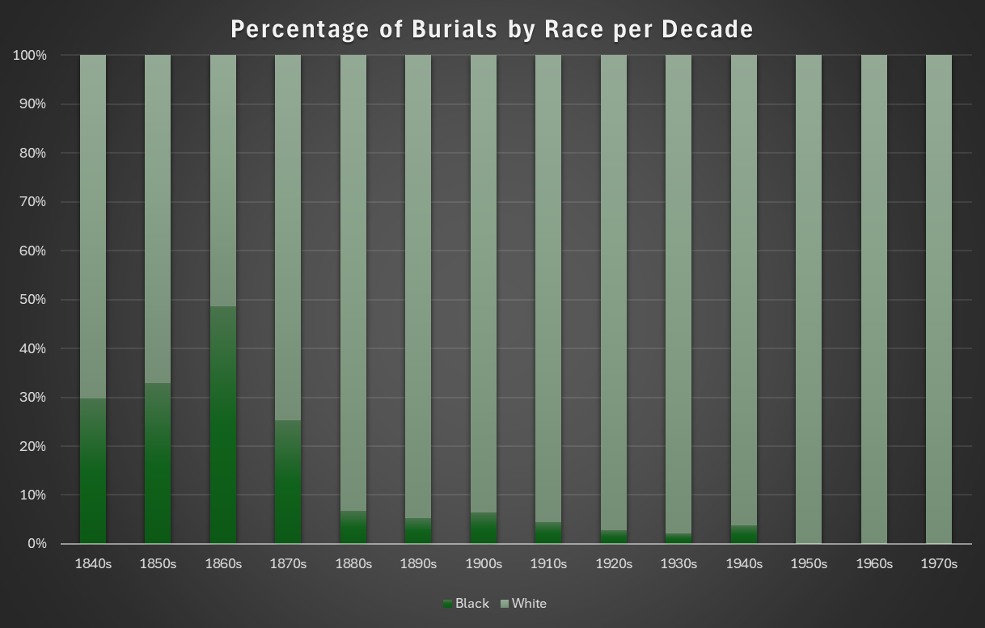

Slide 4
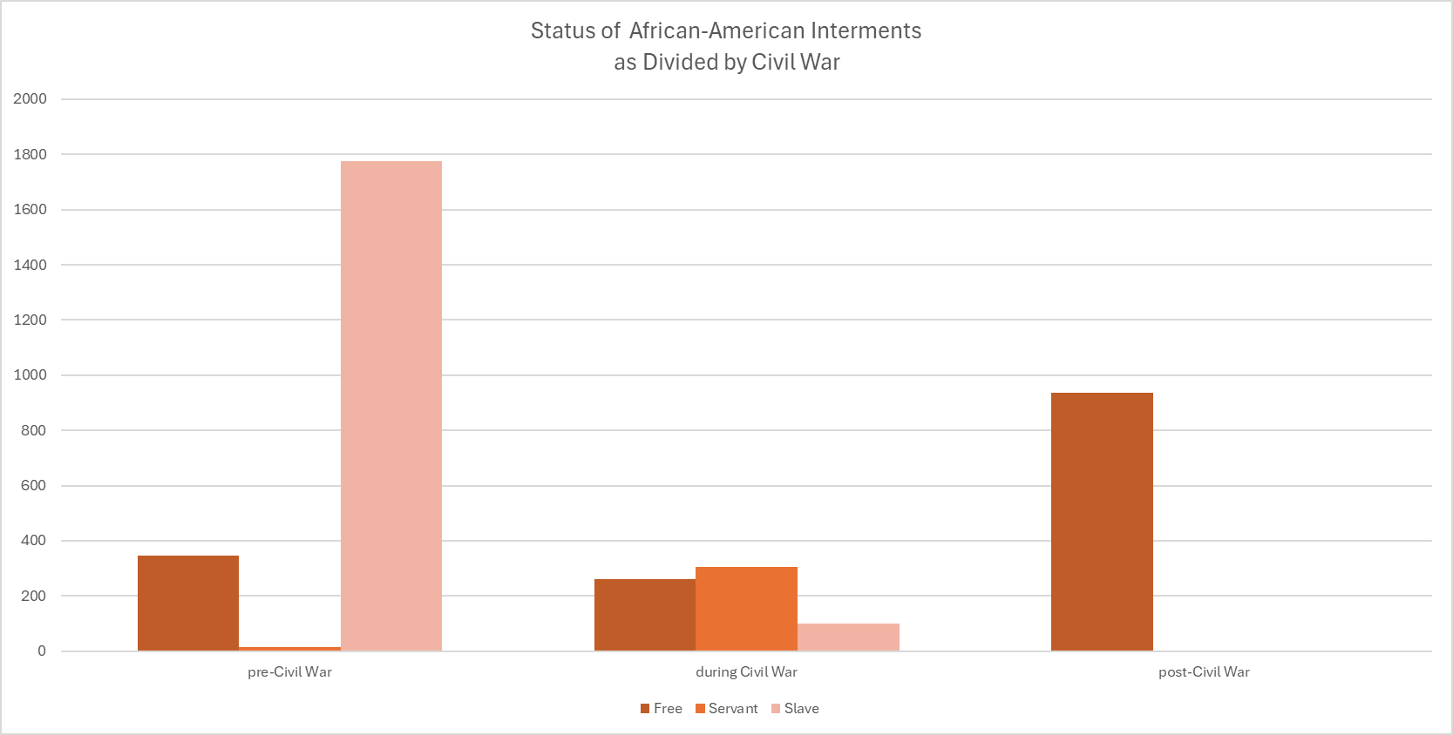

Slide 5
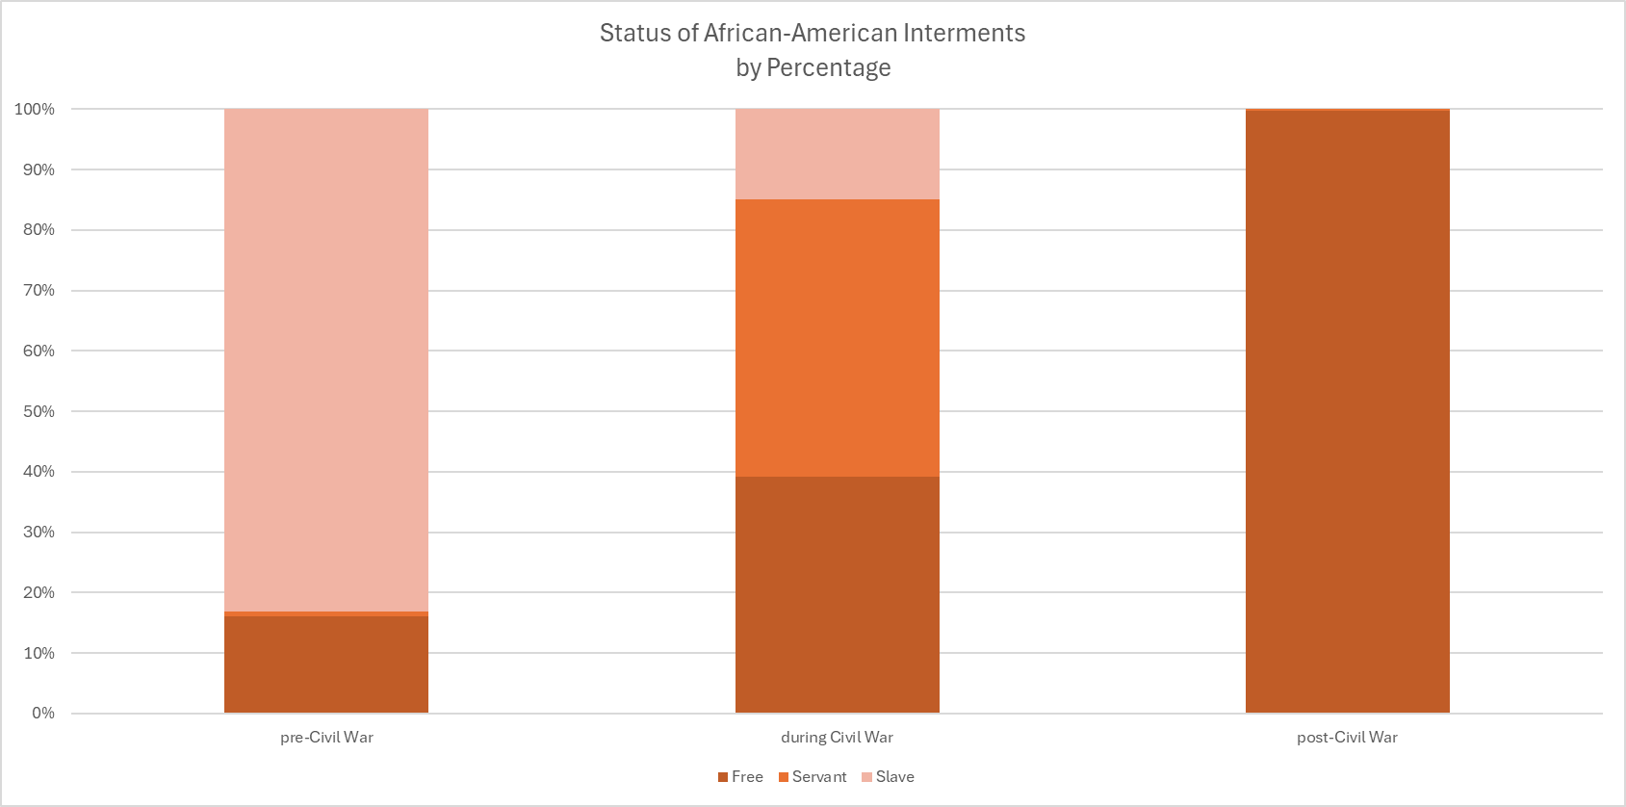
*Free include recodes noted as f. w. c. and f. m. c.

Slide 6
Black girl Age 12 slave of Mrs. Clough
Coloured Man Age 0 slave of J. McEwing

